Slide 1
Progress Report

Slide 2
Progress from last week
Modification on the code
  Redone the support generation, now will always generate all possible combinations if the training/test size allows.
  Tested GPU implementation, has high GPU memory cost but not GPU efficient
    actually become slower than CPU implementation
    requires further tuning
  Done loss ratio vs. detection test on a larger scale
  Doing cosets vs. detection test on a larger scale
  Done cross-entropy loss implementation

Slide 3
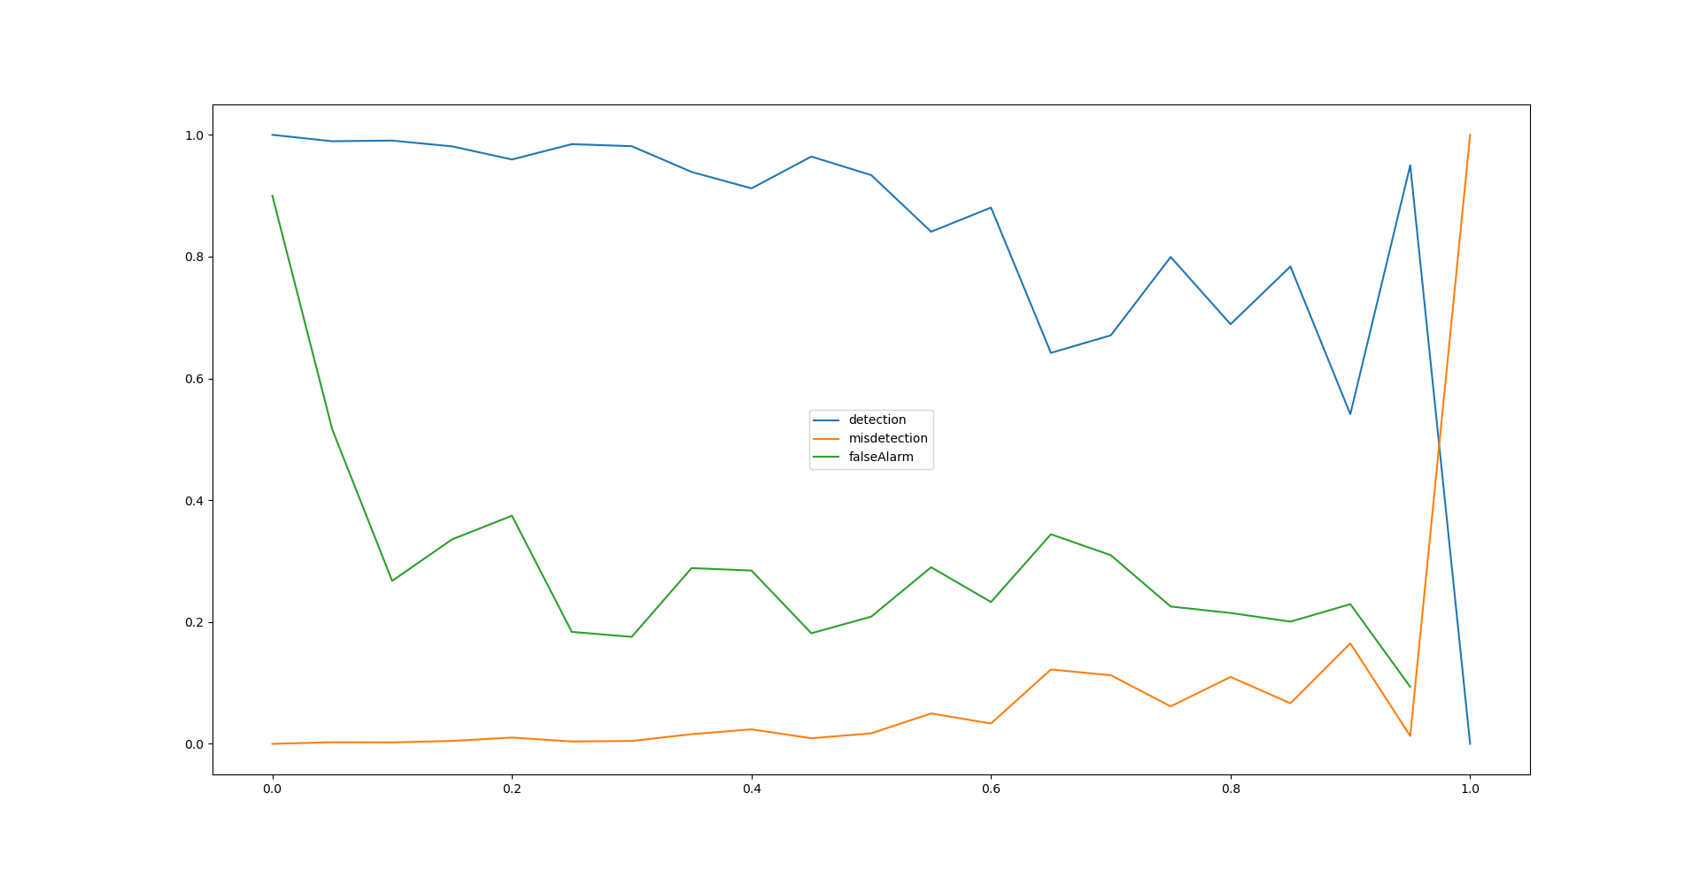
Loss ratio vs. detection

Slide 4
Cross-entropy Loss
Old implementation is regression based
  when we have 40 subbands
  output a vector with length 40, each entry is a float number
  threshold is used to acquire the final result
Pros:
  scales better with number of subbands/occupied bands
  smaller network->faster training
Cons:
  Cannot explicitly choose how many bands are occupied

Slide 5
Cross-entropy Loss 2
New implementation:
  For example, for 40 subbands and 4 occupied bands, there are 91390 possible combinations.
  The NN outputs a vector with length 91390, encoding the probability of input belongs to one of 91390 classes.
Pros:
  Will always output one class among 91390 possible results
  Never give more/less occupied bands, helpful for controlling false alarm
  frequently used as classification metric
Cons:
  Scales bad, trains slow

Slide 6
Cross-entropy Loss 3
Done a small scale test:
  102400/102400 - 237s - loss: 1.4391 - accuracy: 0.7845 (training)
  10000/10000 - 21s - loss: 1.5004 - accuracy: 0.7750 (test)
  14897.83156824112 (time)
Much slower, one epoch takes 4-6 mins (old implementation takes 10s)
The accuracy is evaluated as exact match.
Also done a test on 10/2/5 set, got 100% accuracy as old implementation did-> the method itself is valid.

Slide 7
Work in progress
Server
  The hardware of the server seems faulty, it will hang up without a reason.
Cross-entropy modification
  We can also treat each sub-band as seperated classification task.
    Pros: much forgiving computational complexity
    Cons: lost correlation among the sub bands
  Proper detection/misdetection/falsealarm metric
    The whole output structure changed, thus old metric would not work
Frequency domain input

